Slide 1
Exception Handling
Unit – 3
Part 1

Slide 2
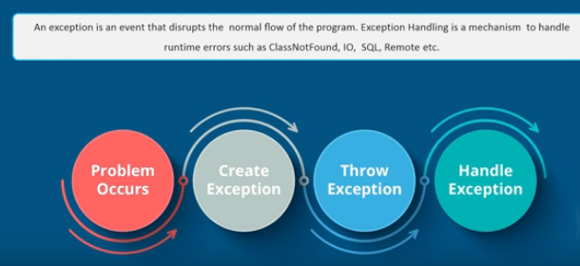
Exception Handling

Slide 3
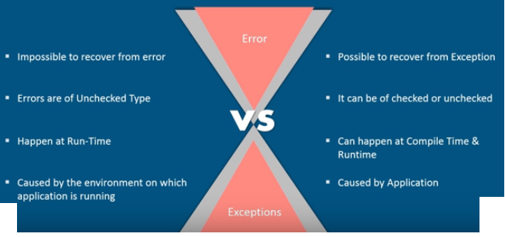
Error v/s Exception

Slide 4
What is an Exception?
An exception is an unexpected event that occurs during runtime and causes normal program flow to be disrupted.
Some common examples:
Divide by zero errors
Accessing the elements of an array beyond its range
Invalid input
Hard disk crash
Opening a non-existent file
Invalid data entry

Slide 5
Exceptions Handling
A powerful mechanism to handle the runtime errors.
Exception = an abnormal condition.
Here exception is an event that disrupts the normal flow of the program.
In Java exception is an object which is thrown at runtime.

Slide 6
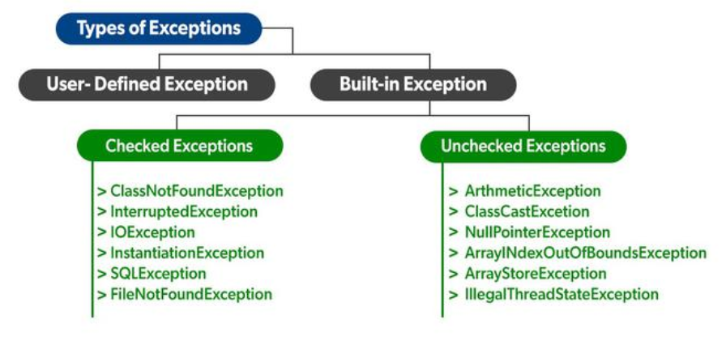

Slide 7
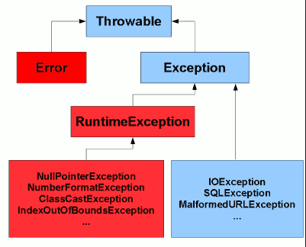
Java Exception classes

Slide 8
Types of Exception
Checked Exception:
The classes that extend Throwable class except RuntimeException and Error are known as checked exceptions e.g.IOException, SQLException etc.
Checked exceptions are checked at compile-time.
Unchecked Exception:
The classes that extend RuntimeException are known as unchecked exceptions e.g. ArithmeticException, NullPointerException etc.
Unchecked exceptions are checked at runtime.
Error:
Error is irrecoverable e.g. OutOfMemoryError

Slide 9
Checked Exception | Unchecked Exception
Occur at compile time. | Occur at runtime.
Checked by the compiler. | The compiler does not check
Can be handled at the time of compilation. | Cannot be a catch or handle at the time of compilation, because they get generated by the mistakes in the program.
They are the sub-class of the exception class. | Not a part of the Exception class.
Here, the JVM needs the exception to catch and handle. | Here, the JVM does not require the exception to catch and handle.
Examples of Checked exceptions: File Not Found Exception No Such Field Exception Interrupted Exception No Such Method Exception Class Not Found Exception | Examples of Unchecked Exceptions: No Such Element Exception Undeclared Throwable Exception Empty Stack Exception Arithmetic Exception Null Pointer Exception Array Index Out of Bounds Exception Security Exception

Slide 10
Keywords of Exception Handling
There are 5 keywords used in Java exception handling.
try
catch
finally
throw
throws

Slide 11
try-catch block
Java try block
Java try block is used to enclose the code that might throw an exception.
It must be used within the method.
Java try block must be followed by either catch or finally block.
Java catch block
Java catch block is used to handle the Exception.
It must be used after the try block only.
The catch block allows you to define a block of code to be executed, if an error occurs in the try block.
You can use multiple catch block with a single try.

Slide 12
Java try-catch
Syntax of Java try-catch :
try
{
//code that may throw exception
}
catch(Exception_class_Name ref)
{
-----
}
Syntax of try-finally block
try
{ //code that may throw exception }
finally
{
-------
}

Slide 13
Without exception handling
class Trycatch
{
public static void main(String args[])
{
int data=50/0;//may throw exception
System.out.println("rest of the code...");
}
}
Output:
Exception in thread main java.lang.ArithmeticException:/ by zero

Slide 14
Using Exception handling
class Trycatch_Ex
{ public static void main(String args[])
{
try
{ int data=50/0; }
catch(ArithmeticException e)
{System.out.println(e);}
System.out.println("rest of the code...");
}
}
Output:
Exception in thread main java.lang.ArithmeticException:/ by zero
rest of the code...

Slide 15
Multiple Catch block
A single try block can have multiple catch blocks. This is required when the try block has statements that generates different types of exceptions.
If the first catch block contains the Exception class object then the subsequent catch blocks are never executed.
The last catch block in multiple catch blocks must contain the Exception class object.
try
{
// Statements which can cause exception
}
catch(Exceptiontype1 e1)
{ ------ }
catch(Exceptiontype2 e2)
{ ------ }
catch(Exceptiontype3 e3)
{ ------ }
Example

Slide 16
Nested try block
Try block within a try block is known as nested try block.
Sometimes a situation may arise where a part of a block may cause one error and the entire block itself may cause another error. In such cases, exception handlers have to be nested.
try
{
statement 1;
try { statement 1; }
catch(Exception e) { }
}
catch(Exception e)
{
}
Example

Slide 17
Various Exceptions….
Exception | Meaning
ArithmeticException | Arithmetic error, such as divide-by-zero.
ArrayIndexOutOfBoundsException | Array index is out-of-bounds.
IllegalArgumentException | Illegal argument used to invoke a method.
IndexOutOfBoundsException | Some type of index is out-of-bounds.
NullPointerException | Invalid use of a null reference.
NumberFormatException | Invalid conversion of a string to a numeric format.

Slide 18
finally block
finally block is a block that is used to execute important code such as closing connection, stream etc.
It must be followed by try or catch block.
finally block is always executed no matter whether there is an exception or not.
The finally block is optional.
For each try block, there can be only one finally block.
try
{
//Protected code
}
catch(ExceptionType1 e1)
{
//Catch block
}
catch(ExceptionType1 e1)
{
//Catch block
}
finally
{
//The finally block always executes.
}
Example

Slide 19
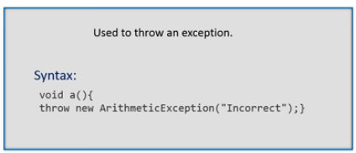
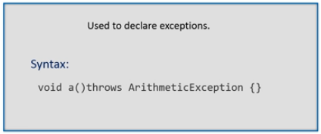
throw v/s throws

Slide 20
Throw keyword
Used to explicitly throw a single exception.
We can throw either checked or unchecked exception in Java by throw keyword.
The throw keyword is mainly used to throw custom exception.
Syntax :
throw exception;
For example :
throw new IOException("sorry device err);

Slide 21
Example
class TestThrow
{ static void validate(int age)
{
if(age<18)
throw new ArithmeticException("not valid");
else
System.out.println("welcome to vote");
}
public static void main(String args[])
{
validate(13);
System.out.println("rest of the code...");
}
}
Output: Exception in thread main java.lang.ArithmeticException: not valid

Slide 22
Throws keywords
throws keyword is used to declare the type of exceptions that might occur within the method.
It is used in the method declaration.
It is always used with method signature.
The throws keyword is used to declare an exception.
Syntax :
return_type method_name() throws exception class_name
{
….....
}
Example

Slide 23
Difference between throw & throws
throw keyword | throws keyword
1) throw is used to explicitly throw an exception. | throws is used to declare an exception.
2) throw is followed by an instance. | 2) throws is followed by class.
3) throw is used within the method. | 3) throws is used with the method signature.
4) Checked exception can not be propagated with throw only | 4) Checked exception can be propagated with throws
5) You cannot throw multiple exception Ex. throw new IOException(“Error…”) | 5) You can declare multiple exception e.g. public void method()throws IOException,SQLException.

Slide 24
Java Custom Exception
If you are creating your own Exception that is known as custom exception or user-defined exception.
Java custom exceptions are used to customize the exception according to user need.
By the help of custom exception, you can have your own exception and message.
Example

Slide 25
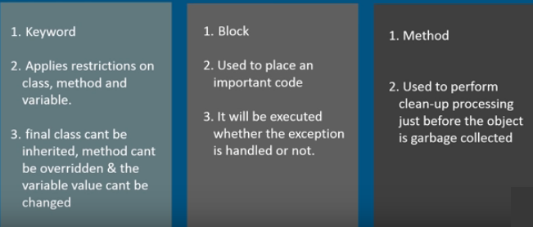
final v/s finally v/s finalize

